Slide 1
Modelling techniques

Slide 2
Different types of Modelling
Verilog HDL (Hardware Description Language) offers various modeling techniques that allow engineers to describe digital hardware at different levels of abstraction.
Following are the four different levels of abstraction which can be described by four different coding styles of Verilog language:
Behavioral or Algorithmic level
Dataflow level
Gate level or Structural level
Switch level

Slide 3
Structural / Gate Level Modeling
The module is implemented in terms of logic gates and interconnections between these gates. Design at this level is similar to describing a design in terms of a gate-level logic diagram.
It provides a textual description of a schematic diagram.
Verilog recognizes 12 basic gates as predefined primitives.
4 primitive gates of 3-state type.
Other 8 are: and, nand, or, nor, xor, xnor, not, buf
When the gates are simulated, the system assigns a four-valued logic set to each gate – 0,1,unknown (x) and high impedance (z)
When a primitive gate is incorporated into a module, we say it is instantiated in the module.

Slide 4
Classification of primitives
Verilog primitives
and / or
buf / not
Tri-state
buf
not
bufif0
bufif1
notif0
notif1
and
nand
or
nor
xor
xnor

Slide 5
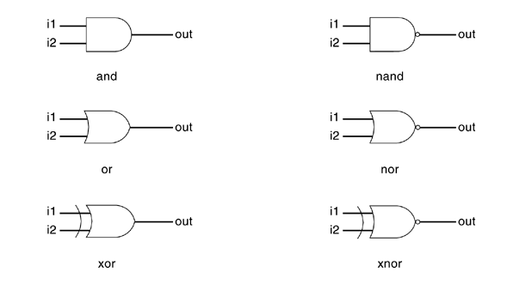
Verilog Logic Gate Primitives
Verilog supports basic logic gates as predefined primitives.
These primitives are instantiated like modules except that they are predefined in Verilog.
No module definition is needed for using the primitives.

Slide 6
Primitive gates
Features:
1-output, multiple inputs.
Output transitions (0, 1, x).
and i1 (output, input_1, input_2, …, input_n);
nand i2 (output, input_1, input_2, …, input_n);
or i3 (output, input_1, input_2, …, input_n);
nor i4 (output, input_1, input_2, …, input_n);
xor i5 (output, input_1, input_2, …, input_n);
xnor i6 (output, input_1, input_2, …, input_n);

Slide 7
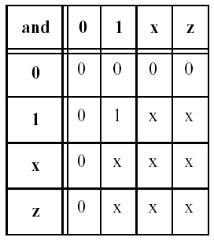
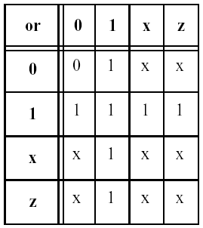
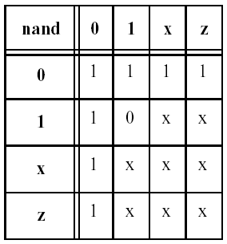
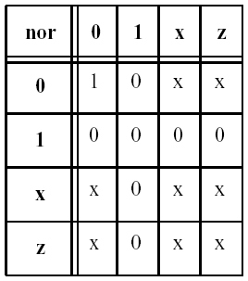
AND / OR PRIMITIVES TRUTH TABLE

Slide 8
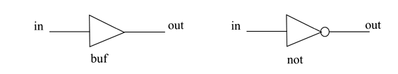
buf / not primitives
Features:
1-input, multiple outputs.
Output transitions (0, 1, x).
buf i1 (output_1, output_2, …, output_n, input);
not i2 (output_1, output_2, …, output_n, input);

Slide 9
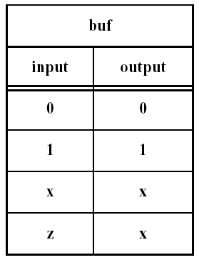
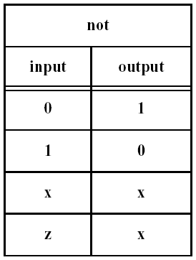
BUF / NOT PRIMITIVES TRUTH TABLE

Slide 10
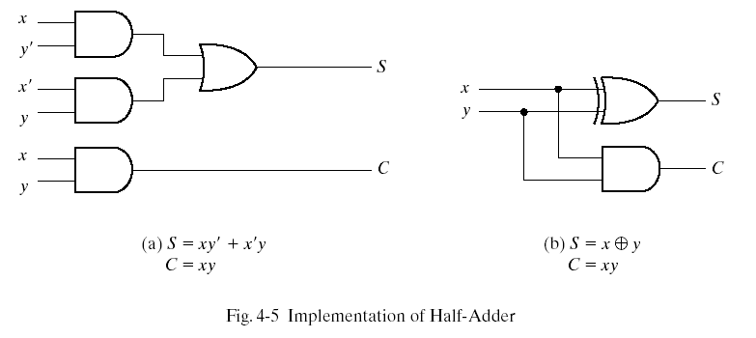
Example - Primitive Instantiation
Half Adder
w1
w2
module halfadder (S,C,x,y);
input x,y;
output S,C;
wire w1,w2,xnot,ynot; // internal signal
//Instantiate primitive gates
not n1(xnot,x);
not n2(ynot,y);
and a1(w1,x,ynot);
and s2(w2,xnot,y);
or o1(S,w1,w2);
and a2( C,x,y);
endmodule
module halfadder (S,C,x,y);
input x,y;
output S,C;
//Instantiate primitive gates
xor x1(S,x,y);
and a1(C,x,y);
endmodule

Slide 11
Module Instantiation - Example
module mux4 (a,b,c,d,se1, y);
input a,b,c,d,se1;
output y;
wire y,se1,w1,w2;
mux2 t1(a,b,se1,w1);
mux2 t2(c,d,se1,w2);
mux2 t3(w1,w2,se1,y);
endmodule
module mux2 (a,b,s,y);
input a,b,s;
output y;
wire y,s1,w1,w2;
not n1(s1,s);
and a1(w1,a,s);
and a2 (w2,b,s1);
or o1(y,w1,w2);
endmodule

Slide 12
Connecting Ports to External Signals
There are two methods of making connections between signals specified in the module instantiation and the ports in a module definition. These two methods cannot be mixed.
Connecting by ordered list
Connecting ports by name

Slide 13
Connecting by ordered list
Connecting by ordered list is the most intuitive method for most beginners.
The signals to be connected must appear in the module instantiation in the same order as the ports in the port list in the module definition

Slide 14
Connecting Ports by name
For large designs where modules have, say, 50 ports, remembering the order of the ports in the module definition is impractical and error-prone.
Verilog provides the capability to connect external signals to ports by the port names, rather than by position.

Slide 15
Connecting Ports by name -Example
module frmux (a,b,c,d,se1, y);
input a,b,c,d,se1;
output y;
wire y,se1,w1,w2;
twmux t1(.a(a), .b(b), .s(se1), .y(w1) );
twmux t2(.a (c), .b(d), .s(se1), .y(w2) );
twmux 3(.a(w1), .b(w2), .s(se1), .y(y));
endmodule
module twmux (a,b,s,y);
input a,b,s;
output y;
wire y,s1,w1,w2;
not n1(s1,s);
and a1(w1,a,s);
and a2 (w2,b,s1);
or o1(y,w1,w2);
endmodule

Slide 17
Dataflow Modeling
Gate level Modeling approach works well for small circuits but not for complex designs.
Designers can design more effectively if they concentrate on implementing the function at a level of abstraction higher than gate level.
Dataflow modeling provides a powerful way to implement a design.
Verilog allows a circuit to be designed in terms of the data flow between registers and how a design processes data rather than instantiation of individual gates.

Slide 18
Cont’d..
With gate densities on chips increasing rapidly, dataflow modeling has assumed great importance.
Currently, automated tools are used to create a gate-level circuit from a dataflow design description. This process is called logic synthesis.
The data flow modeling allows the designer to concentrate on optimizing the circuit in terms of data flow.
In the digital design community, the term RTL (Register Transfer Level) design is commonly used for a combination of dataflow modeling and behavioral modeling.

Slide 19
Continuous assignment
This level of abstraction level resembles like that of boolean equation representation of digital systems.
The dataflow assignments are called “Continuous Assignments”.
Continuous assignments are always active.
Syntax: assign #(delay) target = expression;
A Verilog module can contain any number of continuous assignment statements, and all staements execute concurrently.

Slide 20
Cont’d..
LHS target -> always a net, not a register.
RHS -> registers, nets or function calls.
Delay values can be specified in terms of time units.
Whenever an event (change of value) occurs on any operand used on the RHS of an expression, the expression is evaluated and assigned to the LHS target.

Slide 21
Types of continuous assignments
Regular continuous assignment.
wire mux_out, a_in, b_in, sel_in;
assign mux_out = sel_in ? b_in : a_in;
Implicit continuous assignment.
wire a_in, b_in, sel_in;
wire mux_out = sel_in ? b_in : a_in;

Slide 22
Continuous assignment examples
wire and_out;
assign and_out = i1 & i2; // regular continuous assignment
wire exor_out = i1[31:0] ^ i2[31:0] // implicit assignment
module generate_mux (a,b,f,s);
input a,b;
input s;
output f;
wire f;
assign f = s? a : b;
endmodule
a
b
MUX
f
s
Note: Conditional Operator generate MUX

Slide 23
Example – Decoder Inference
module generate decoder (data,select,out);
input data;
input [0:1]select;
output [0:3] out;
wire [0:3] out;
assign out[select]=data;
endmodule
D
A
T
A
DECODER
OUT
SELECT
Note: Non- constant index in expression on LHS generates DECODER

Slide 24
Example – ADDER and COMPARATOR
//Dataflow description of 4-bit adder
module binary_adder (A,B,Cin,SUM,Cout);
input [3:0] A,B;
input Cin;
output [3:0] SUM;
output Cout;
assign {Cout,SUM} = A + B + Cin;
endmodule
//Dataflow description of a 4-bit comparator.
module magcomp (A,B,ALTB,AGTB,AEQB);
input [3:0] A,B;
output ALTB,AGTB,AEQB;
assign ALTB = (A < B),
AGTB = (A > B),
AEQB = (A == B);
endmodule

Slide 25
Behavioral Modeling

Slide 26
Behavioral or algorithmic level:
This is the highest level of abstraction provided by Verilog HDL. A module can be implemented in terms of the desired design algorithm without concern for the hardware implementation details. Designing at this level is very similar to C programming.
It is used mostly to describe sequential circuits, but can also be used to describe combinational circuits.
There are two structured procedures in Verilog:
initial
always
Concurrent execution is observed in between these procedures.
Only registers can be assigned in these procedures.
The assignments in these procedures are called “procedural assignments”.
The target output of procedural assignment statements must be of the reg data type.

Slide 27
initial statement
Starts execution at ‘0’ simulation time and executes only once during the entire simulation.
Multiple statements in initial block can be grouped with (begin & end) or (fork & join) keywords.
These blocks are not synthesizable.
initial blocks cannot be nested.
Each initial block represent a separate and independent activity.
initial blocks are used in generating test benches.

Slide 28
initial block structures
initial
xor_out = in1 ^ in2;
initial
begin
and_out = a_in & b_in;
end
initial
begin
clk = 1’b0;
reset = 1’b0;
initial
begin
#100 reset = 1’b1;
#20 clk = 1’b1;
end
end
initial
begin
enable = 1’b0;
rst = 1’b0;
#100 rst = 1’b1;
#20 enable = 1’b1;
end

Slide 29
always statement
Starts execution at ‘0’ simulation time and is active all through out the entire simulation.
Multiple statements inside always block can be grouped with (begin & end) or (fork & join) keywords.
Execution of always blocks is controlled by using the timing control.
always blocks cannot be nested.
An always block without any sensitivity control will create an infinite loop and execute forever.
Each always block represent a separate and independent activity.
These blocks can synthesize to different hardware depending on their usage.
always block with timing control are synthesizable.

Slide 30
always block structures
always @(a_in or b_in)
begin
and_out = a_in & b_in;
end
always
xor_out = in1 ^ in2;
always
begin
cnt = 1’b0;
reset = 1’b0;
always @(posedge clk)
begin
#100 cnt = 1’b1;
#20 enable = 1’b1;
end
end
always @(posedge reset)
begin
if (reset == 1’b1)
q_out = 1’b0;
else
q_out = d_in;
end

Slide 31
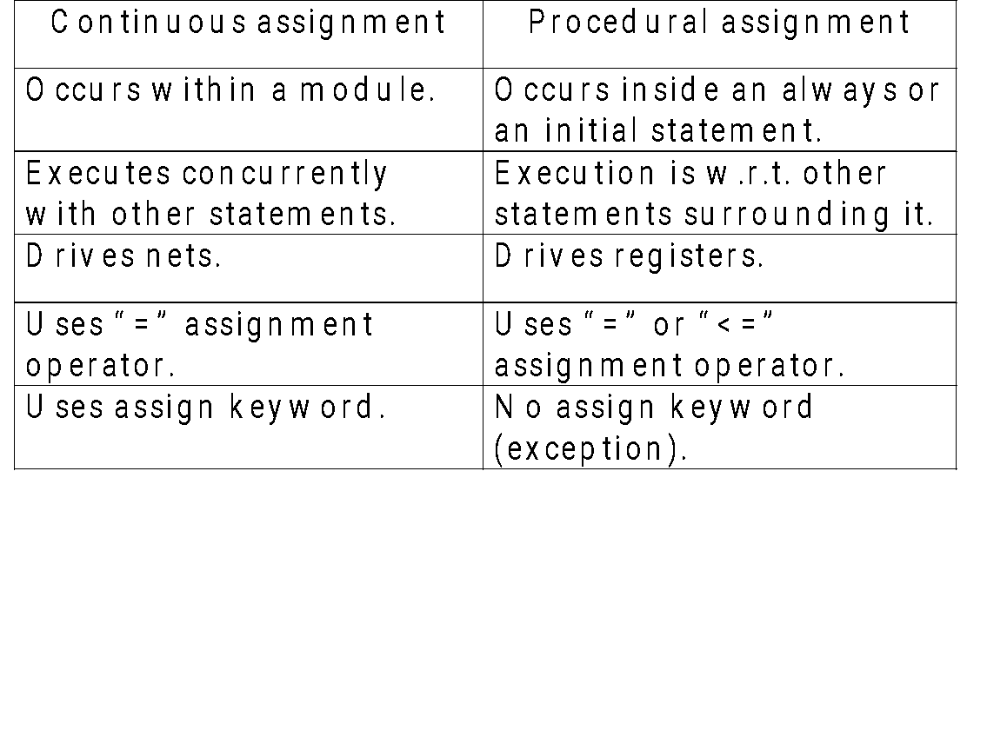
Continuous Vs. procedural assignments

Slide 32
Procedural assignments
These are for updating reg, integer, real, time and their bit / part selects.
The values of the variables can get changed only by another procedural assignment statement.
Procedural assignments are of two types
blocking procedural assignment (executed sequentially in the order they are listed in a sequential block)
non-blocking procedural assignment (evaluate the expressions on the right hand side, but do not make the assignment to the left hand side until all expressions are evaluated)

Slide 33
Blocking Assignment
Most Commonly used type
The target of assignment gets updated before the next sequential statement in procedural block is executed.
A statement using blocking assignment blocks the execution of the statements following it, until it gets completed.
B = A
C = B + 1
Recommended style for modeling combinational logic.(data dependency)

Slide 34
Non-Blocking Assignment
The assignments to the target gets scheduled for the end of the simulation cycle.
Normally occurs at the end of the sequential block (begin ….. end)
Statements subsequent to the instruction under the consideration are not blocked by the assignment.
Recommended style for modeling sequential logic
- Can be used to assign several ‘reg’ type variables synchronously, under the control of a common block
B <= A
C <= B + 1
A variable cannot appear as the target of both a blocking and a non-blocking assignment.
Following is not permissible
value = value +1;
value <=init;

Slide 35
Procedural timing controls
Delay based timing control
Event based timing control
Level sensitive timing control

Slide 36
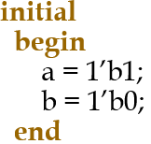
Delay based timing control
Regular delay control
Format:
#<delay_value> <target> = RHS expression;
It is used to delay the execution of the corresponding procedural statement by the defined delay value.
e.g. : #10 c = a + b;
Intra assignment delay control
Format:
<target> = #<delay_value> RHS expression;
Intra-assignment delays compute the RHS expression at the current time and defer the assignment of the computed value to the LHS target by the defined delay value.
e.g. : c = #10 a + b;
Zero delay control
Statements with zero delay execute at the end of the current simulation time, when all other statements in the current simulation time have executed.

Slide 37
Event based timing control
An event is the change in the value on a register or a net.
Implicit event: The value changes on nets and registers can be used as events to trigger the execution of a statement.
The event can also be based on the direction of the change.
posedge : change towards the value 1
negedge : change towards the value 0
Types of event based timing control
Regular event control
Event or control

Slide 38
Regular event control
Format:
@(event) statement;
e.g.: @ (ena) q = d;
@ (posedge t_in) q = ~q;
@ (negedge clk) q = d;
@ (posedge clk_in) q_out = d_in;

Slide 39
Event or control
The logical or of any number of events can be expressed such that the occurrence of any one of the events triggers the execution of the procedural statement that follows it.
Format:
always @ (event1 or event2 or event3)
always @ (posedge event1 or negedge event2)
Example-
always @ (in1 or in0 or sel_in)
begin
if (sel_in == 1’b0)
mux_out = in0;
else
mux_out = in1;
end

Slide 40
Behavioral constructs
if-else statements
The if construct checks a specific condition and decides execution based on the result.
assignment 1;
if(condition) assignment2;
assignment3;
assignment4;
After execution of assignment1, the condition specified is checked . If it is
satisfied , assignment2 is executed; if not it is skipped.
In either case the execution continues through assignment3, assignment4, etc.
Execution of assignment2 alone is dependent on the condition. The rest of the sequence remains.

Slide 41
if-else and if-elseif-else statements
if (<expression 1>)
begin
true_statements 1;
end
:
:
else if (<expression n>)
begin
true_statements n;
end
else
begin
default_statements;
end
if (<expression>)
begin
true_statements;
end
if (<expression>)
begin
true_statements;
end
else
begin
false statements;
end

Slide 42
Conditional statement - Examples
if (!ena = 1’b1)
begin
out = in1 & in2;
end
if (in1 == 1’b0 && in2 == 1’b0)
dec_o1 = 1’b1;
else if (in1 == 1’b0 && in2 == 1’b1)
dec_o2 = 1’b1;
else if (in1 == 1’b1 && in2 == 1’b0)
dec_o3 = 1’b1;
else
dec_o4 = 1’b1;
if (sel == 1’b0)
begin
mux_out = in0;
end
else
begin
mux_out = in1;
end

Slide 43
case statement
case (expression)
alternative 1:begin
end
alternative 2:begin
end
alternative 3:begin
end
default: begin
end
endcase
This is a multiway decision statement that tests whether an expression matches one of a number of other alternatives.
Doesn’t treat ‘x’ & ‘z’ as don’t cares.

Slide 44
case statement - Example
module mux4_to_1 (out, i0, i1, i2, i3, s1, s0); output out;
input i0, i1, i2, i3;
input s1, s0;
reg out;
always @(s1 or s0 or i0 or i1 or i2 or i3)
case ({s1, s0})
2'd0 : out = i0;
2'd1 : out = i1;
2'd2 : out = i2;
2'd3 : out = i3;
default: $display("Invalid control signals");
endcase
endmodule

Slide 45
Example-Behavioral Modeling
//Behavioral description of 2-to-1-line multiplexer
module mux2x1_bh(A,B,select,OUT);
input A,B,select;
output OUT;
reg OUT;
always @(select or A or B)
if (select == 1)
OUT = A;
else
OUT = B;
endmodule
//Behavioral description of 4-to-1 line mux
module mux4x1_bh (i0,i1,i2,i3,select,y);
input i0,i1,i2,i3;
input [1:0] select;
output y;
reg y;
always @(i0 or i1 or i2 or i3 or select)
case (select)
2'b00: y = i0;
2'b01: y = i1;
2'b10: y = i2;
2'b11: y = i3;
endcase
endmodule

Slide 46
Reference
Samir Palnitkar,”Verilog HDL: A Guide to Digital Design and Synthesis” Prentice Hall, Second Edition,2003
Students are encouraged to refer the following website in addition to their class participation and reading required text and reference books.
http://www.asic-world.com/verilog/

